Slide 1

AI COPILOT FOR PRIVILEGED ACCESS
www.authnull.com
Asif Ali, Founder & CEO | a@authnull.com | 916-693-5727

Slide 2






Problem: PAM Solutions Are High Friction, And Dated.
Top 3 Challenges With Legacy Solutions According To Customers
Lack Intelligence
Vaulted Credentials
High Friction & TCO
Lacks Intelligence
Pose a significant attack vector¹
Remain a significant source of credential theft.⁶
Slow onboarding - requires admin & user training³
Significant overhead for IT to setup and manage²
Requires ongoing IT and help-desk support^{5.}
Missing M2M auth features
¹ LastPass has revealed a second attack that compromised encrypted password vaults -The Hacker News
² Why Do PAM Deployments Take (almost) Forever To Complete? -The Hacker News
³ Initial user onboarding process -CyberArk Implementation Program Guide
⁴ Cyberark Siphoning from OKTA after mishandled attack - OKTA Attack
⁴ A typical customer like Broadcom has 1 full time PAM, 1-2 IAM engineers requiring training costing at least $450k a year to just to maintain these systems.
⁵ It costs about equates about 6.5 full time resources for each co to provide support through IT help desk.
⁶ Nearly 50% of all attacks are linked with credential theft, Verizon security investigations report
Notes:
IT help desks are inundated by “Why is my account locked out kind of requests” or “can you please grant me access to this”. Between approving and explaining, IT help desk in large companies like Broadcom typically have full time contractors just responding to IT support tickets.

Slide 3
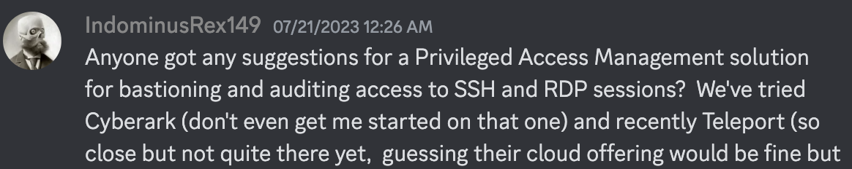
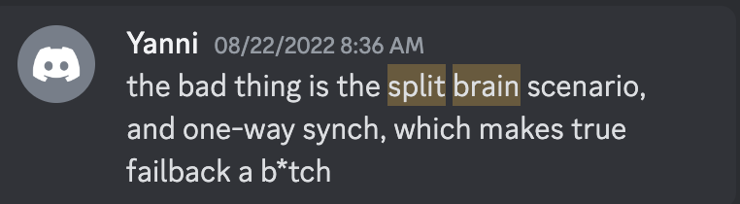
Why Now?
AI can help deliver a better and frictionless experience
Market opportunity1: $2+B, projected growth to $20B by 2030
Incumbents facing challenges due to innovator's dilemma
Workload identity and M2M authentication is an unsolved problem
Alternatives to CyberArk is a common discussion in user groups
¹ https://www.gartner.com/doc/reprints?id=1-2EYAFT0R&ct=230911&st=sb

Slide 4
How It Works
Product Demo

Slide 5
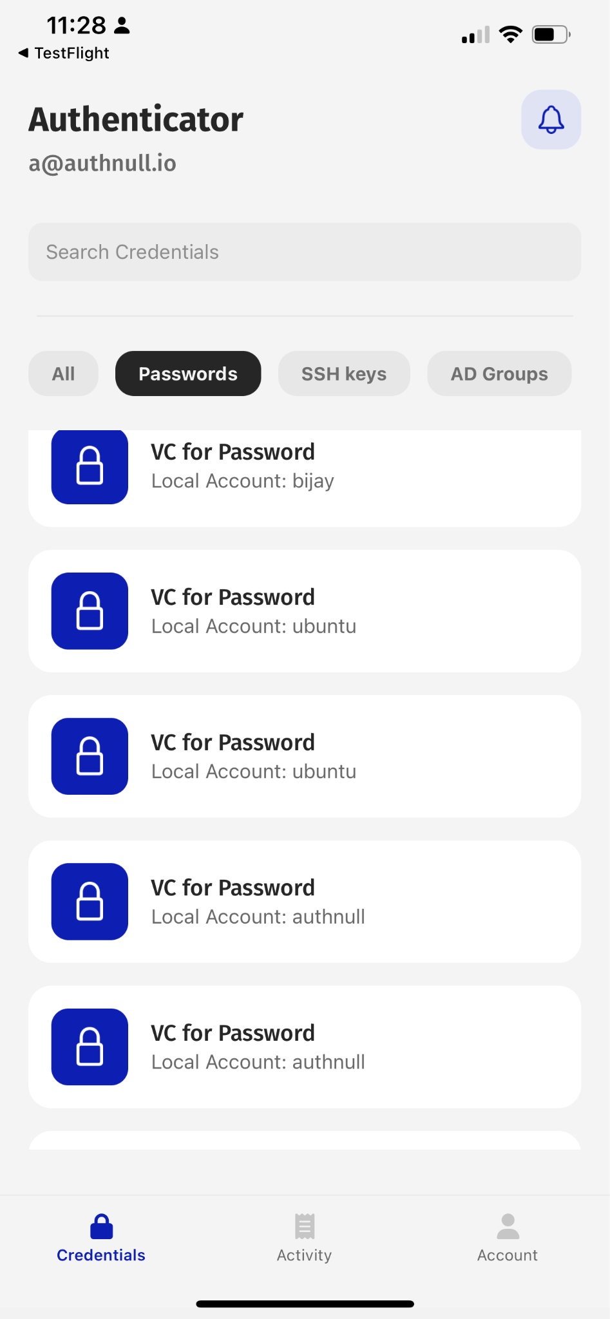
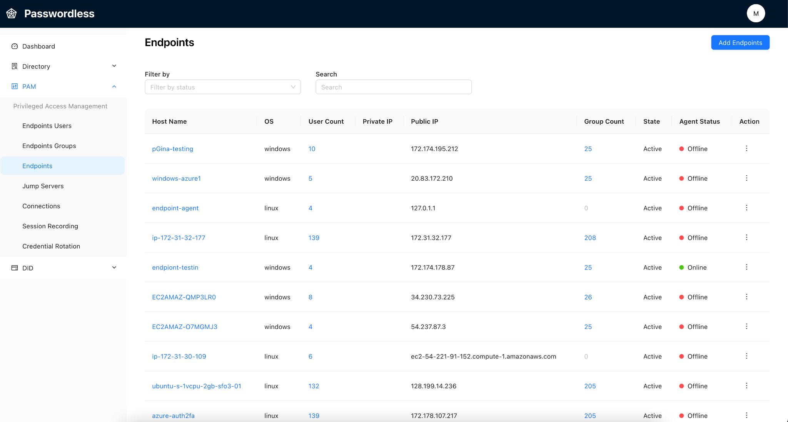
Solution: AuthNull, Is A Modern Privileged Access Platform
Built from ground up to improve security, provide frictionless user experience resulting in lower total cost of ownership (TCO)
AI Security Co-Pilot to reduce the operational overhead & friction for privileged access implementations; reduce help desk overhead.
Vaultless: No centralized vault removes major attack vector. Decentralized.
Modern all-in-one PAM on SaaS eliminates operational overhead. AuthN, AuthZ for all OS and Protocols.
Biometric + Passwordless auth with compatibility for SSH keys and passwords.
Meets NIST AAL2 compliance requirements to use identity, hardware + biometric authentication.

Slide 6
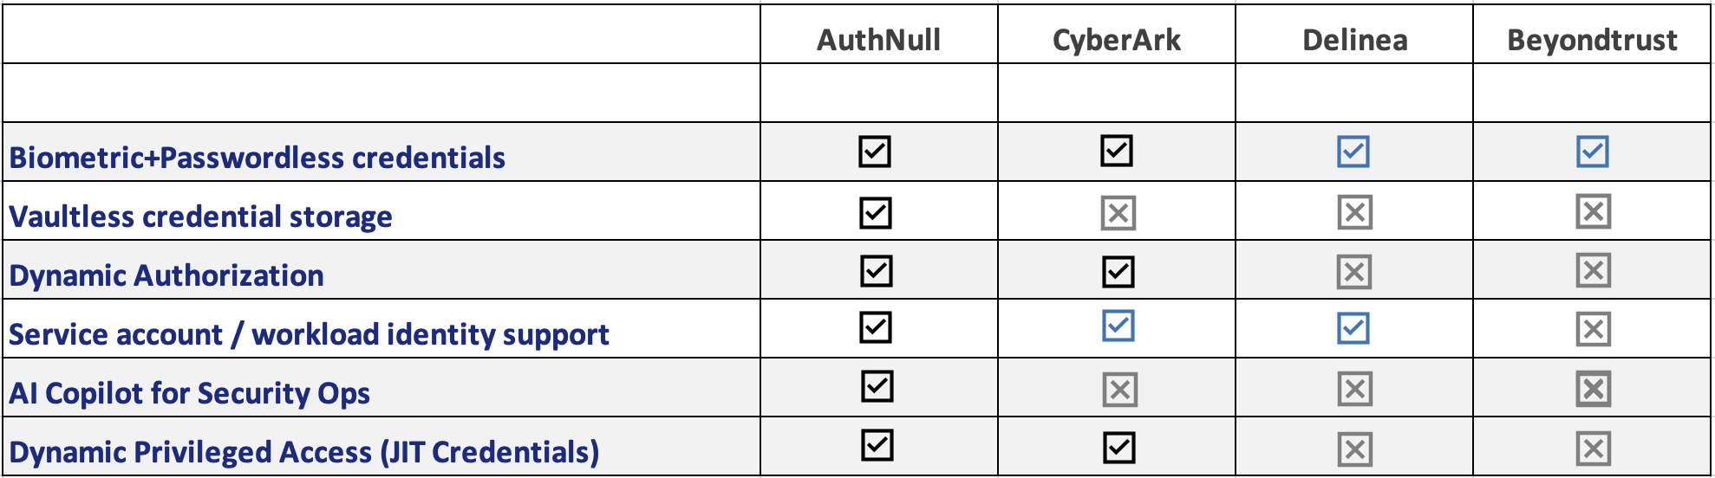
Competitor Matrix
First to leverage AI to reduce IT Ops overhead, and simplify AuthN and AuthZ for PAM.

Slide 7
Business Model & Opportunity
SaaS Pricing Model
Target Customers | ACV | TAM
Year #1 Small Enterprise | $30,000 | $300M
Year #3 Mid & Large Enterprise | $120,000 | $1.2B
$10 /server /month
$5 /user /month
Notes:
Between 0-24 months, a target of 10k businesses with average deal size of $25k per year suggests SAM of $250m.

Slide 8



GTM Strategy
Self service SAAS + Freemium approach
Target Personas
CISOs, VP of IT
Target Verticals
Credit Unions, Banks, Fintech
Large Enterprise IT teams
Lead Generation
Targeted Online & Social Media Ads with communities on Linkedin and Reddit
Outbound cold calling team
Key Value Proposition to gain traction
Self service SAAS PAM

Slide 9


























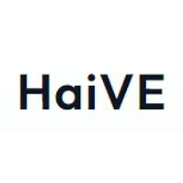



Traction | Pipeline
Potential revenue from the current pipeline exceeds $2m ARR
Strong Interest.
Potential $2m ARR
Purchase order submitted
>$450k ARR
Implementation / POC

Slide 10
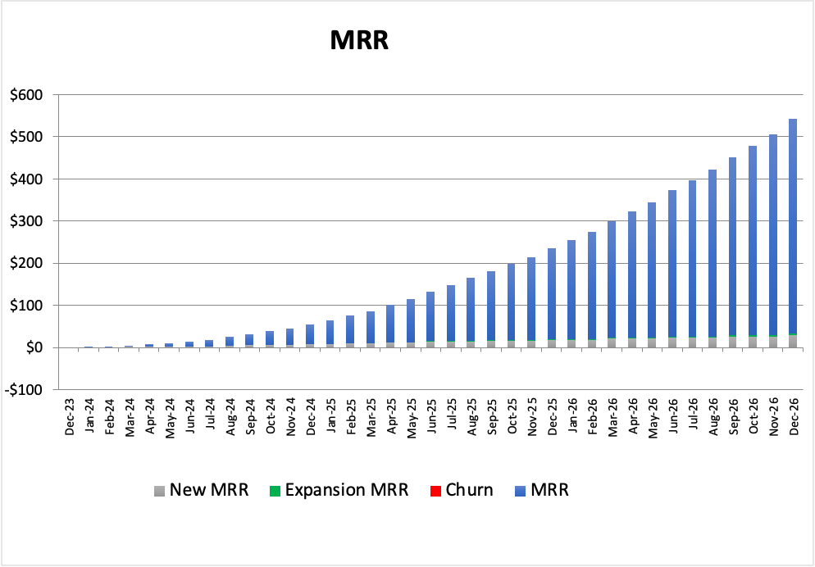
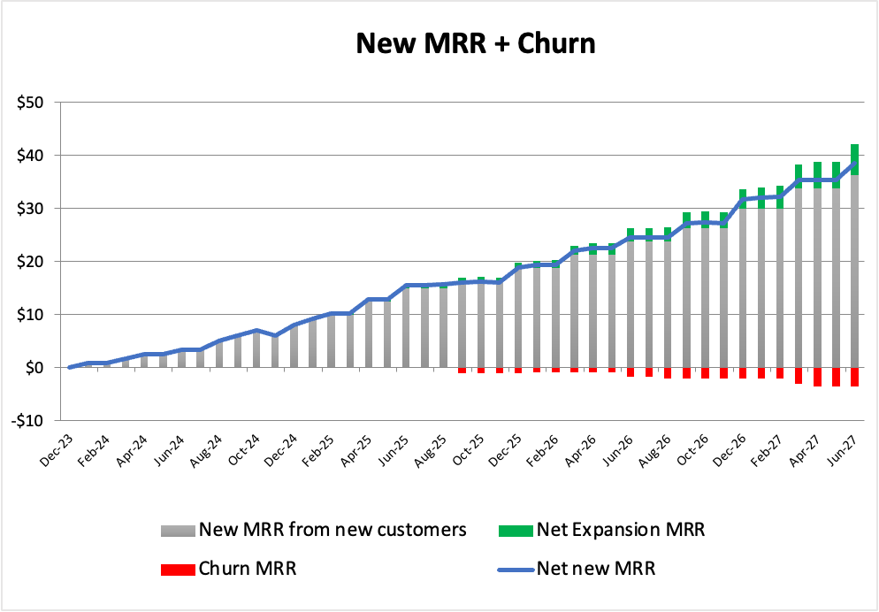
Financial Model
Forecasting $6M ARR in 24 Months.

Slide 11

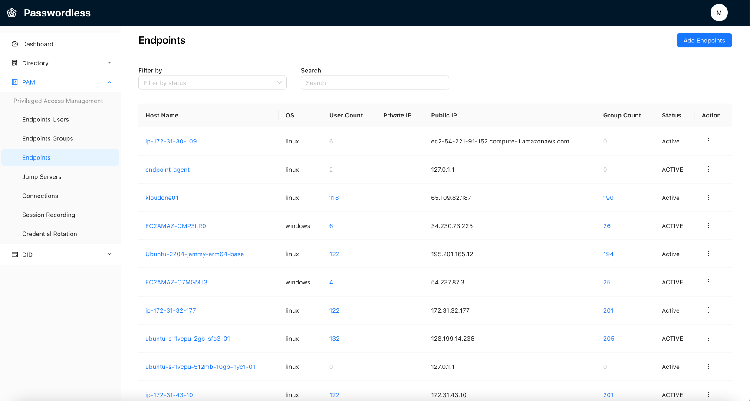

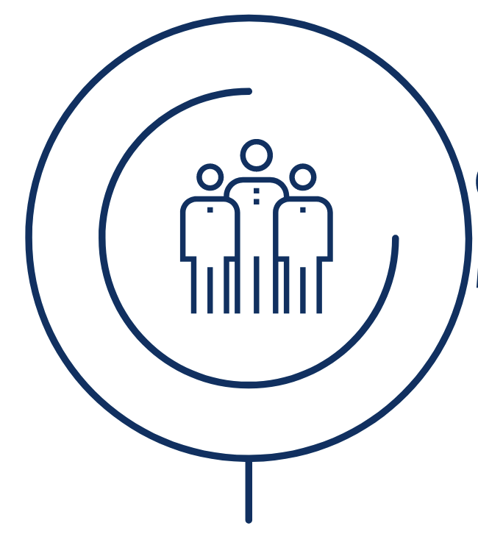
Raising $5M
So Far
Use of Funds
Alpha Prototype
Shipped a product prototype
With two (3) customer POC implementations
Burn rate approx $25k a month:
Product engineering team
Outsourced sales gen team
Engineering:
Setting up a generative AI team
Product development to double down on Privileged Access
GTM / Lead Generation
Reddit, Google Ads
AI Powered SEO

Slide 12
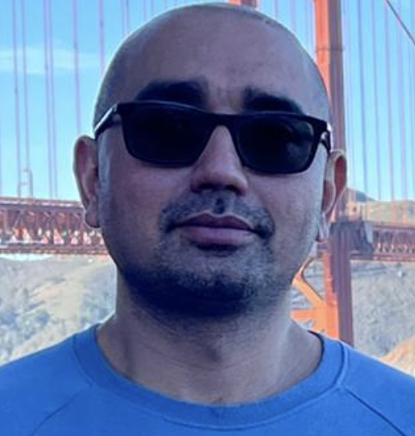

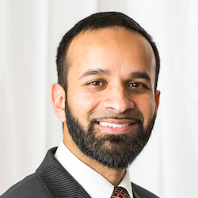

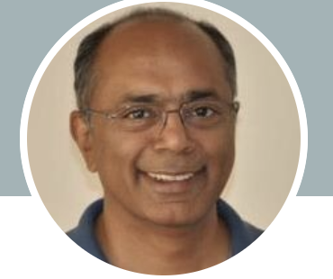
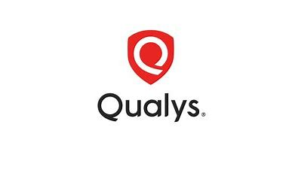







Team
Advisors
Asif Ali
Co-founder, CEO
20+ years of engineering + PLG experience.
Hussain
Co-founder, CTO
15+ years of engineering experience.
Umer Khan
VP Cybersec,
CISO
Nagi Prabhu
CPO
Raghu Toppur
Platform Engineering
TikTok

Slide 13
Vision
AI powered SecOps for Privileged Access
Edge Networks
Advanced PAM use cases
AI Copilot for AuthN - EPM, PAM, AuthZ secops ops
Support for Radius & 802.1X
Windows, Linux PAM
Dynamic AuthZ
Available today
2023 2024 2025

Slide 14
THANK YOU Asif Ali +1 408-368-3404 a@authnull.com
Let’s chat?
Here’s our calendar link to setup a quick discussion.

Slide 15
Appendix

Slide 16




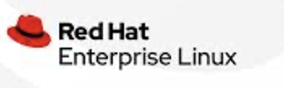

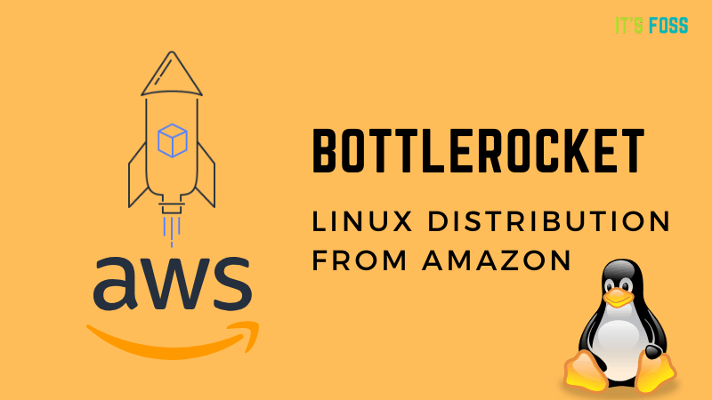
Product Features and Roadmap
Features Today
Near Term
Long term
Privileged Access
- Session recording
- 2FA / Biometric auth
- Passwordless auth
- Windows / Linux
Endpoint
- User management
- Local / LDAP authentication
- Windows EndPoint Management
Secrets Management
- Using wallets
AI Co-pilot
- For Endpoint rules
- For AuthZ rules
- For DPA rules
- Support co-pilot for support queries
Dynamic AuthZ Platform (DAP)
- Rule based dynamic authz
Dynamic Privileged Access (DPA)
- JIT credentials
- AI copilot to help implement
Network Auth
- 802.1x / TACACCESS+ / Radius
- Protect VMWare / Cloud infra
Use AI to automate all aspects of Privileged access without IT admin requirements.
Use AI to automate all aspects of Dynamic Privileged access without IT admin requirements.
MFA with Biometric and/or Passwordless Credentials
Coming Soon
802.1x / Radius
TACACCESS+
Kerberos

Slide 17
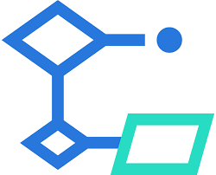
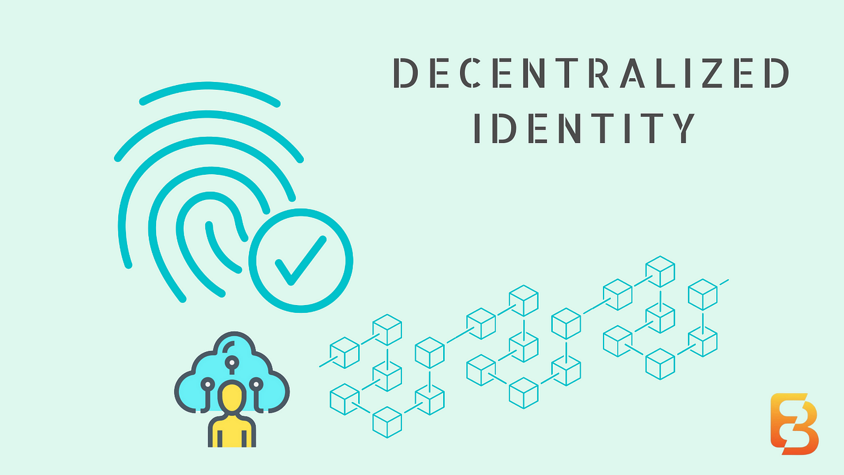
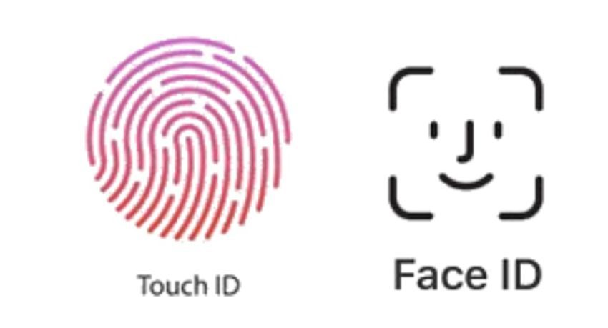
Our solution & differentiation
Decentralized System eliminates Vault
AuthNull delivers a modern PAM as a decentralized id platform with the highest (FIPS 140
FIPS 140—2 compliant DID is based on EDSA / ED25519 signature scheme
Elimination of all major attack vectors without a secrets server.
Passwordless + biometric 2FA authentication
Passwordless + 2FA auth delivers stringent NIST AAL2 compliance.
Dynamic AuthZ
Dynamic authZ provides rule-based conditional access.
It allows users to have true conditional access and modifies permissions on the fly without the need for standing privileges.
AI Copilot
AuthNull provides a conversational chat assistant that can complement and reduce the workload of IT teams. It helps in managing privileged access and dynamic authorization.

Slide 18
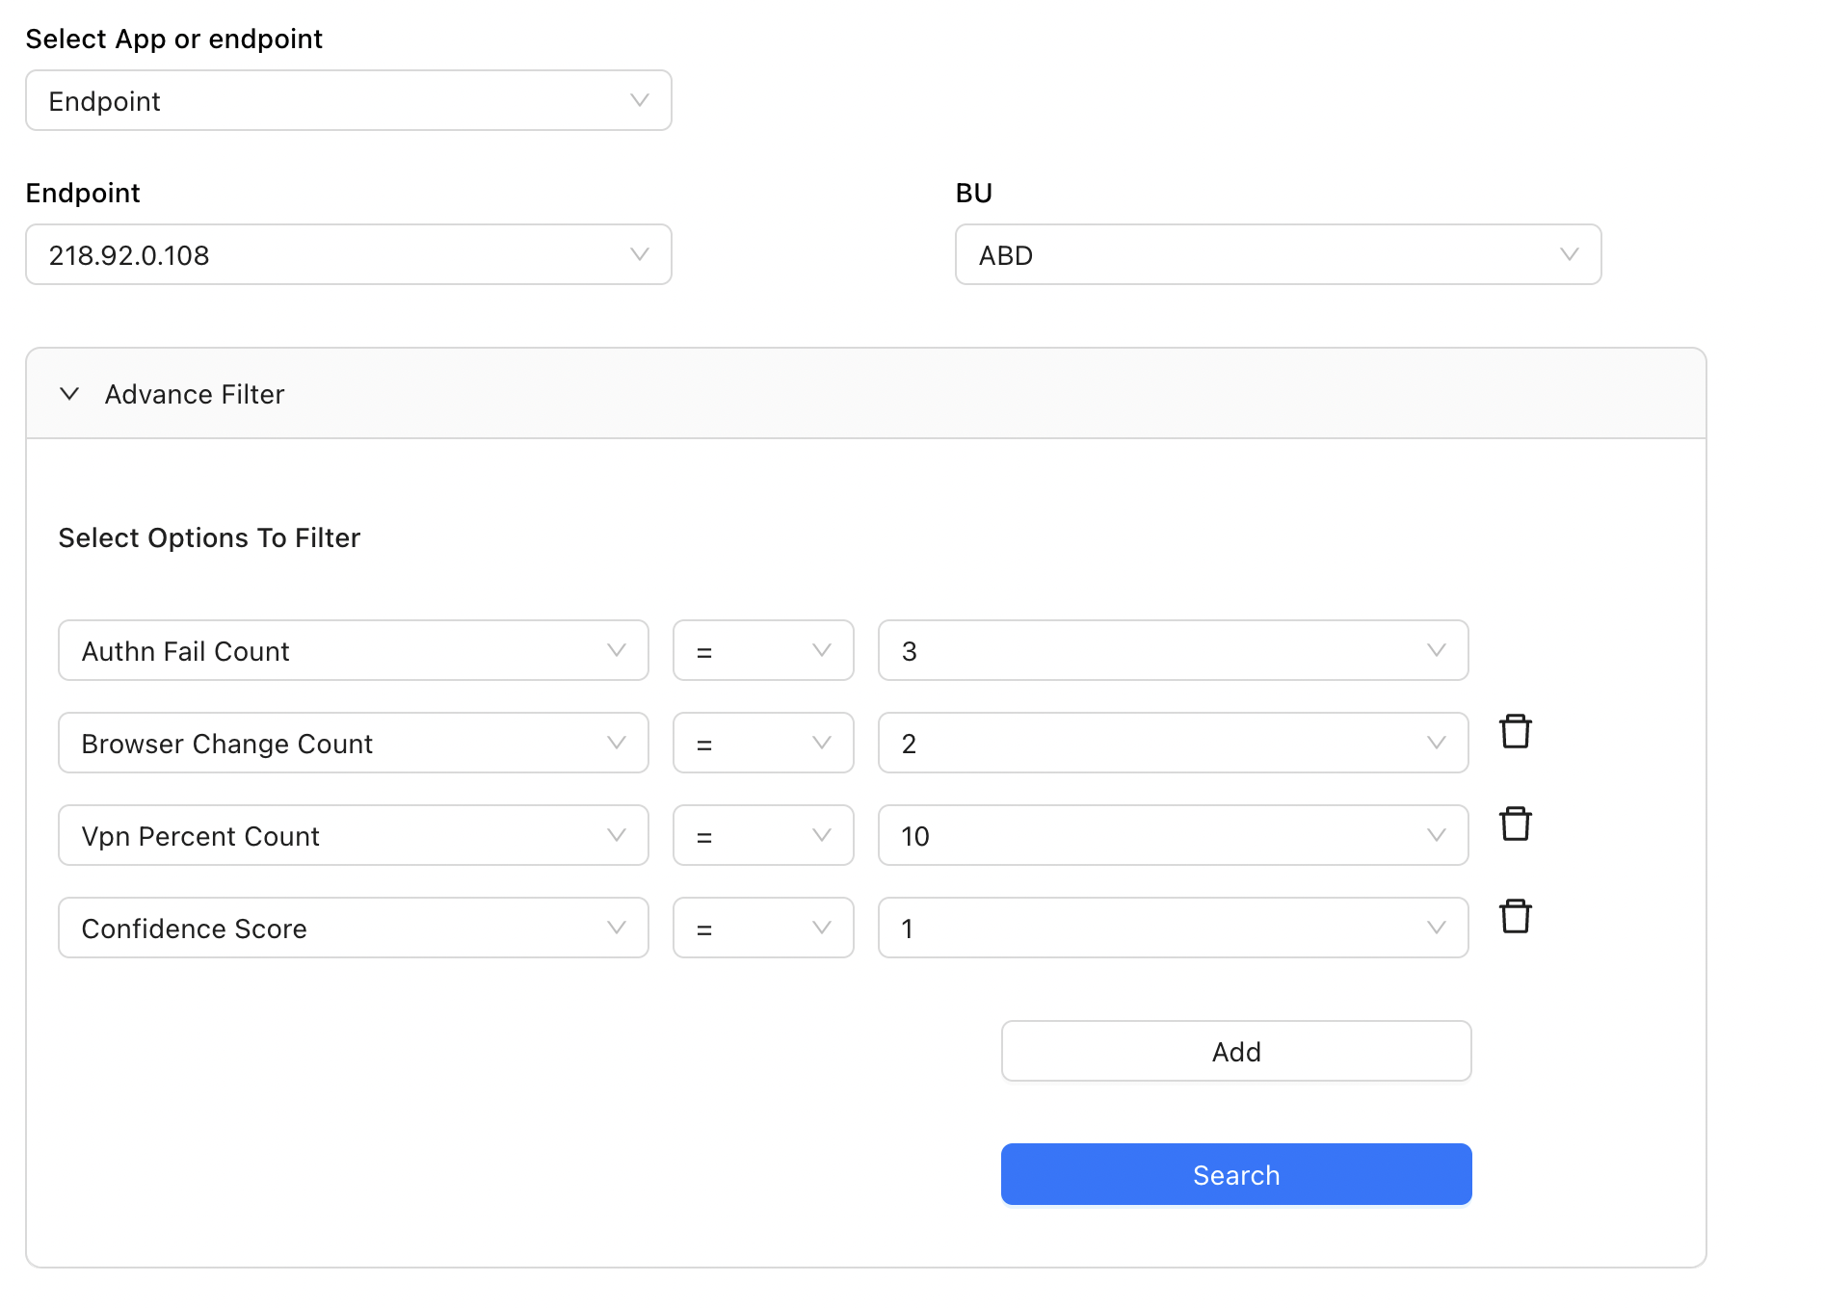
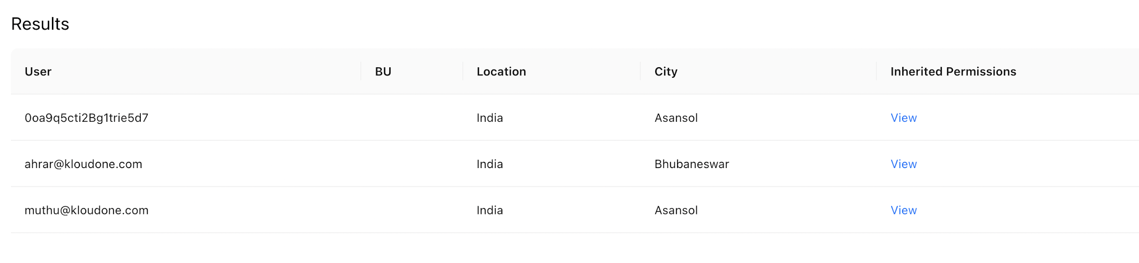
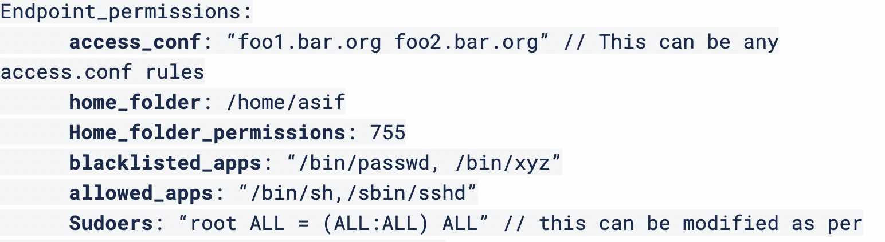
AI Sec Ops
Tab #1
AuthNull aims to deliver a Virtual AI powered staff that uses LLAMA2 / RAG using logs, inherited permissions on target platforms, rules and other dataset available. This tool will act as an IT admin
Who are the high risk users. Recommend rules to strip permissions to these high risk users?
Please explain the users who will get impacted by these new rules you recommended
Tab #2
Sure: Here are the rules that may probably help you define “high risk” users (tab 1)
The users that will be impacted are shown in a new (tab 2)
The permissions impacted are shown in the third tab. Simply save to implement them (tab 3)
Tab #3
Or you can simply respond ”SAVE” and I’ll implement them for you and send the requests to your manager for approval
Yes please SAVE it.
On It!...

